Slide 1

Ralls ISD
HB 5
Student and Community Engagement
Process

Slide 2

Step One:
District Site Base Meeting

Slide 3
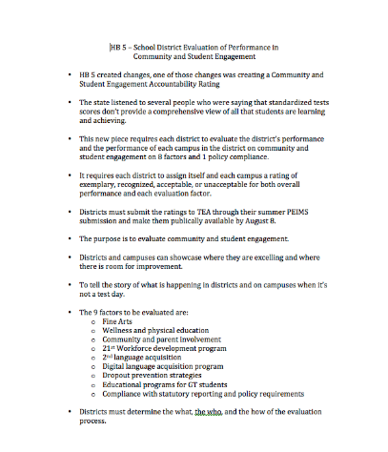
Then Shared This:

Slide 4
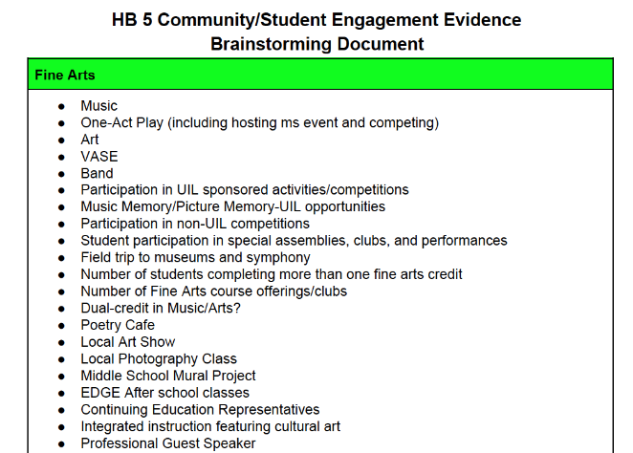
Did This:

Slide 5
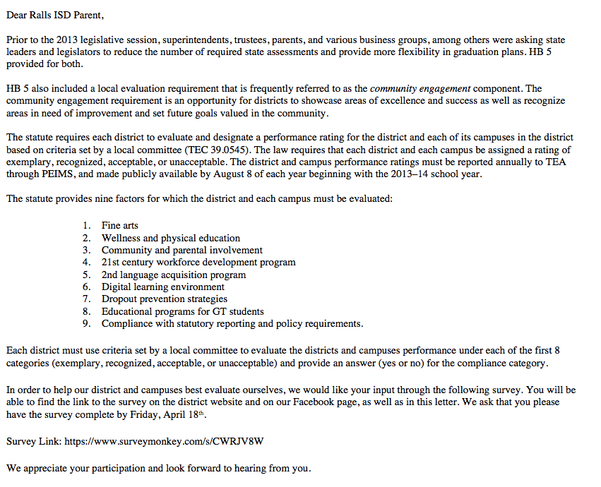
To the Parents:

Slide 6
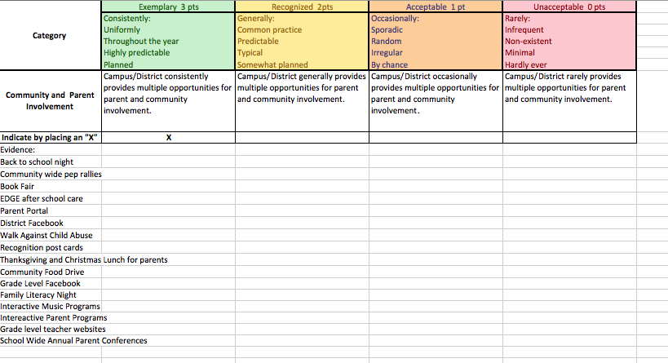
At the Campus:
The Evidence

Slide 7
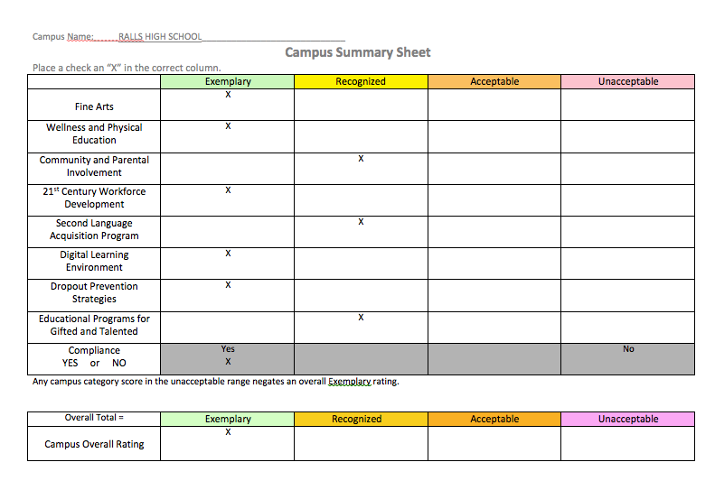
Campus Summary Sheet

Slide 8
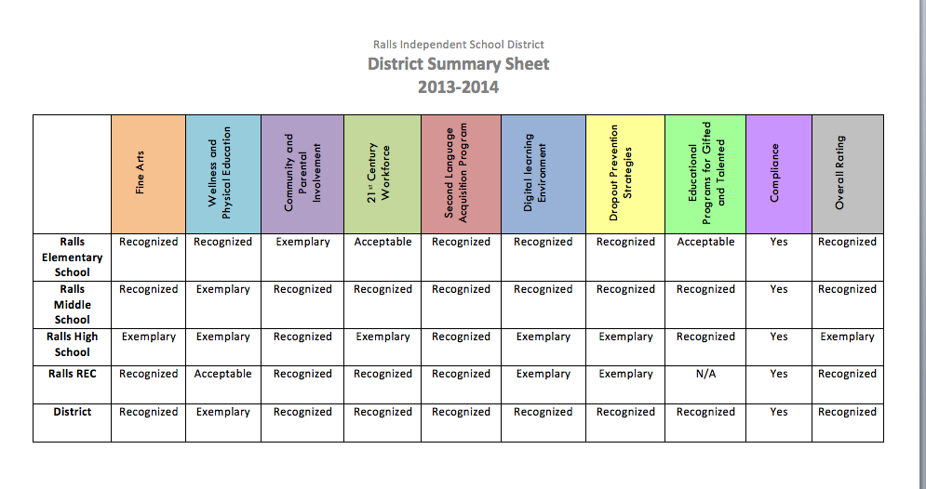
Back to District Site Base:
District Summary Sheet

Slide 9
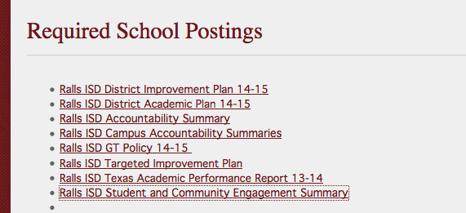
August 8, 2014

Slide 10
Macy Cavazos mcavazos@rallsisd.org
806-253-2571, ext. 4102

Slide 11

Shallowater ISD
HB 5
Student and Community Engagement
Process

Slide 12
Process:
Met with campus principals to determine their method for addressing this requirement under HB 5.
We also shared the LiveBinder with each of the campus administrators. THIS IS AN EXCELLENT RESOURCE!
All campuses ultimately determined to take the template to campus site-base and to work through the ratings there.
Equally, we decided to send a survey out to all community members in Shallowater.
Once compiled, the campus-completed templates where submitted back to central office.
District site-base members met to “average” the campus ratings to determine the district rating.

Slide 13
LiveBinder—HB 5
http://www.livebinders.com/play/play?present=true&id=1130191

Slide 14
Survey Example:
SISD HB5 Community and Student Engagement
1. Campus
Select all that apply.--Shallowater HS Shallowater MS Shallowater Intermediate Shallowater Elementary Shallowater Early
College HS/Woodward
2. Role--Parent School Staff Community
3. Community and Parental Involvement--Provides multiple opportunities for parent and community involvement.
Consistently
Generally
Occasionally
Rarely
Supporting Evidence
4. Fine Arts
Provides opportunities for students to receive instruction in fine arts including visual and performing arts.
Shallowater HS Shallowater MS Shallowater Intermediate Shallowater Elementary Shallowater Early
College HS/Woodward
Consistently
Generally
Occasionally
Rarely
Supporting Evidence

Slide 15
The Results:
Middle School Example:
Self-Rating
Fine Arts: Exemplary
Band
-6th Beginner Band 82/112 kids, 7th Band 54/113 kids, 8th Band 58/135 kids,
-Band sweepstakes 7th and 8th Grade,
-7 Students qualified for all region band
Art
-Art classes, graphic design, 5X30 Glass Tile Mosaic, District 2-T-2 Lions Club Peace Poster Contest: 2011-2013, 280 artworks entered in the West Texas Regional UIL Art Competition 8 years in a row: 82 Honorable Mention, 65 Silver Keys, 42 Gold Keys, 5 students advanced to NYC, One Act Play, Choir and Concerts, Shallowater’s Got Talent, Band Enrichment, UIL events, Summer Theater Camp, Community Theater, high student participation, GT Newscasts.
Education Programs for GT Students: Acceptable
-GT staff certification, UIL, GT classes, Advanced Classes, Differentiated Instruction, Fine Arts, iPads and iMac available in GT classes.

Slide 16
The Results:
Elementary:
 | Unacceptable | Acceptable | Recognized | Exemplary
Fine Arts |  | X
Wellness and Physical Education |  | X
Community and Parental Involvement |  | X
21st Century Workforce Development |  | X
Second Language Acquisition Program |  | X
Digital Learning Environment |  | X
Dropout Prevention Strategies |  | X
Educational Programs for Gifted and Talented |  | X
Compliance: Yes

Slide 17
Kenny Border, Ed.D. kborder@shallowaterisd.net
(806) 832-4531 ext. 2004

Slide 18
Anyone else run into this?
Your “good” campuses scored themselves low.

Slide 19
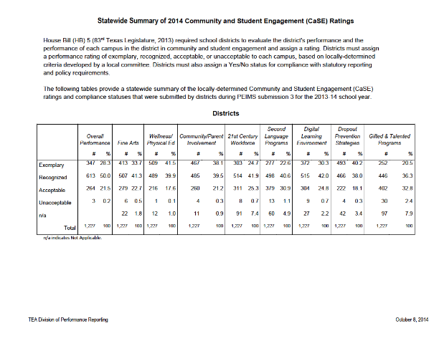
District – State Results

Slide 20
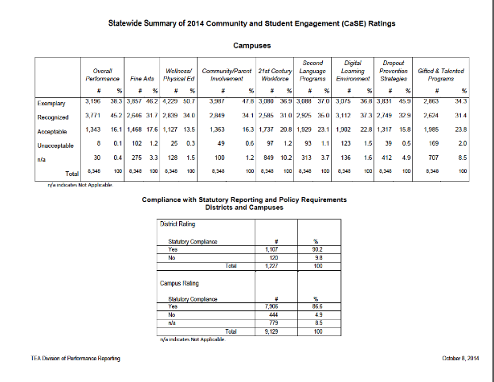
Campus – State Results

